Slide 1
Final Goal Calibration
SimpleLazyTeam
Yueh-Han Chuang Ke Han Yen-Hsiang Huang Han-Yu Lee Jiayi Wang

Slide 2
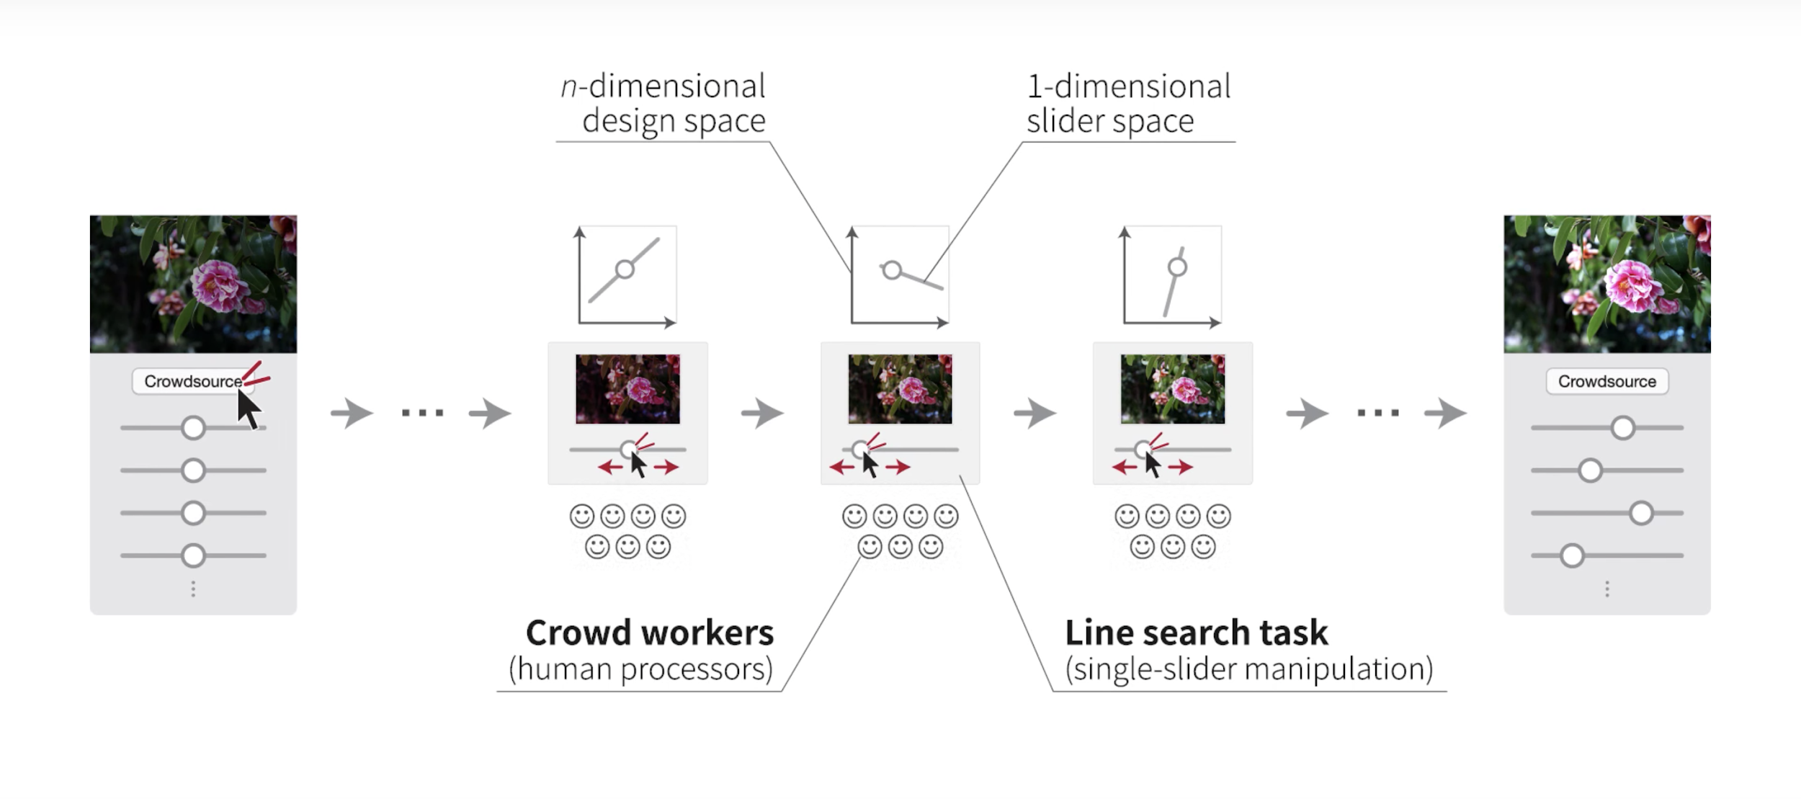
Goal
Decomposes parameter tweaking task into a sequence of one-dimensional line search queries.

Slide 3
Current Progress
GUI:
File I/O
Filters
Math:
Main data structure
Math utilities (probability density function estimation, matrix/vector operation)
Probability model (Gaussian Process, log-normal, log-likelyhood)
Take input, spit random output

Slide 4
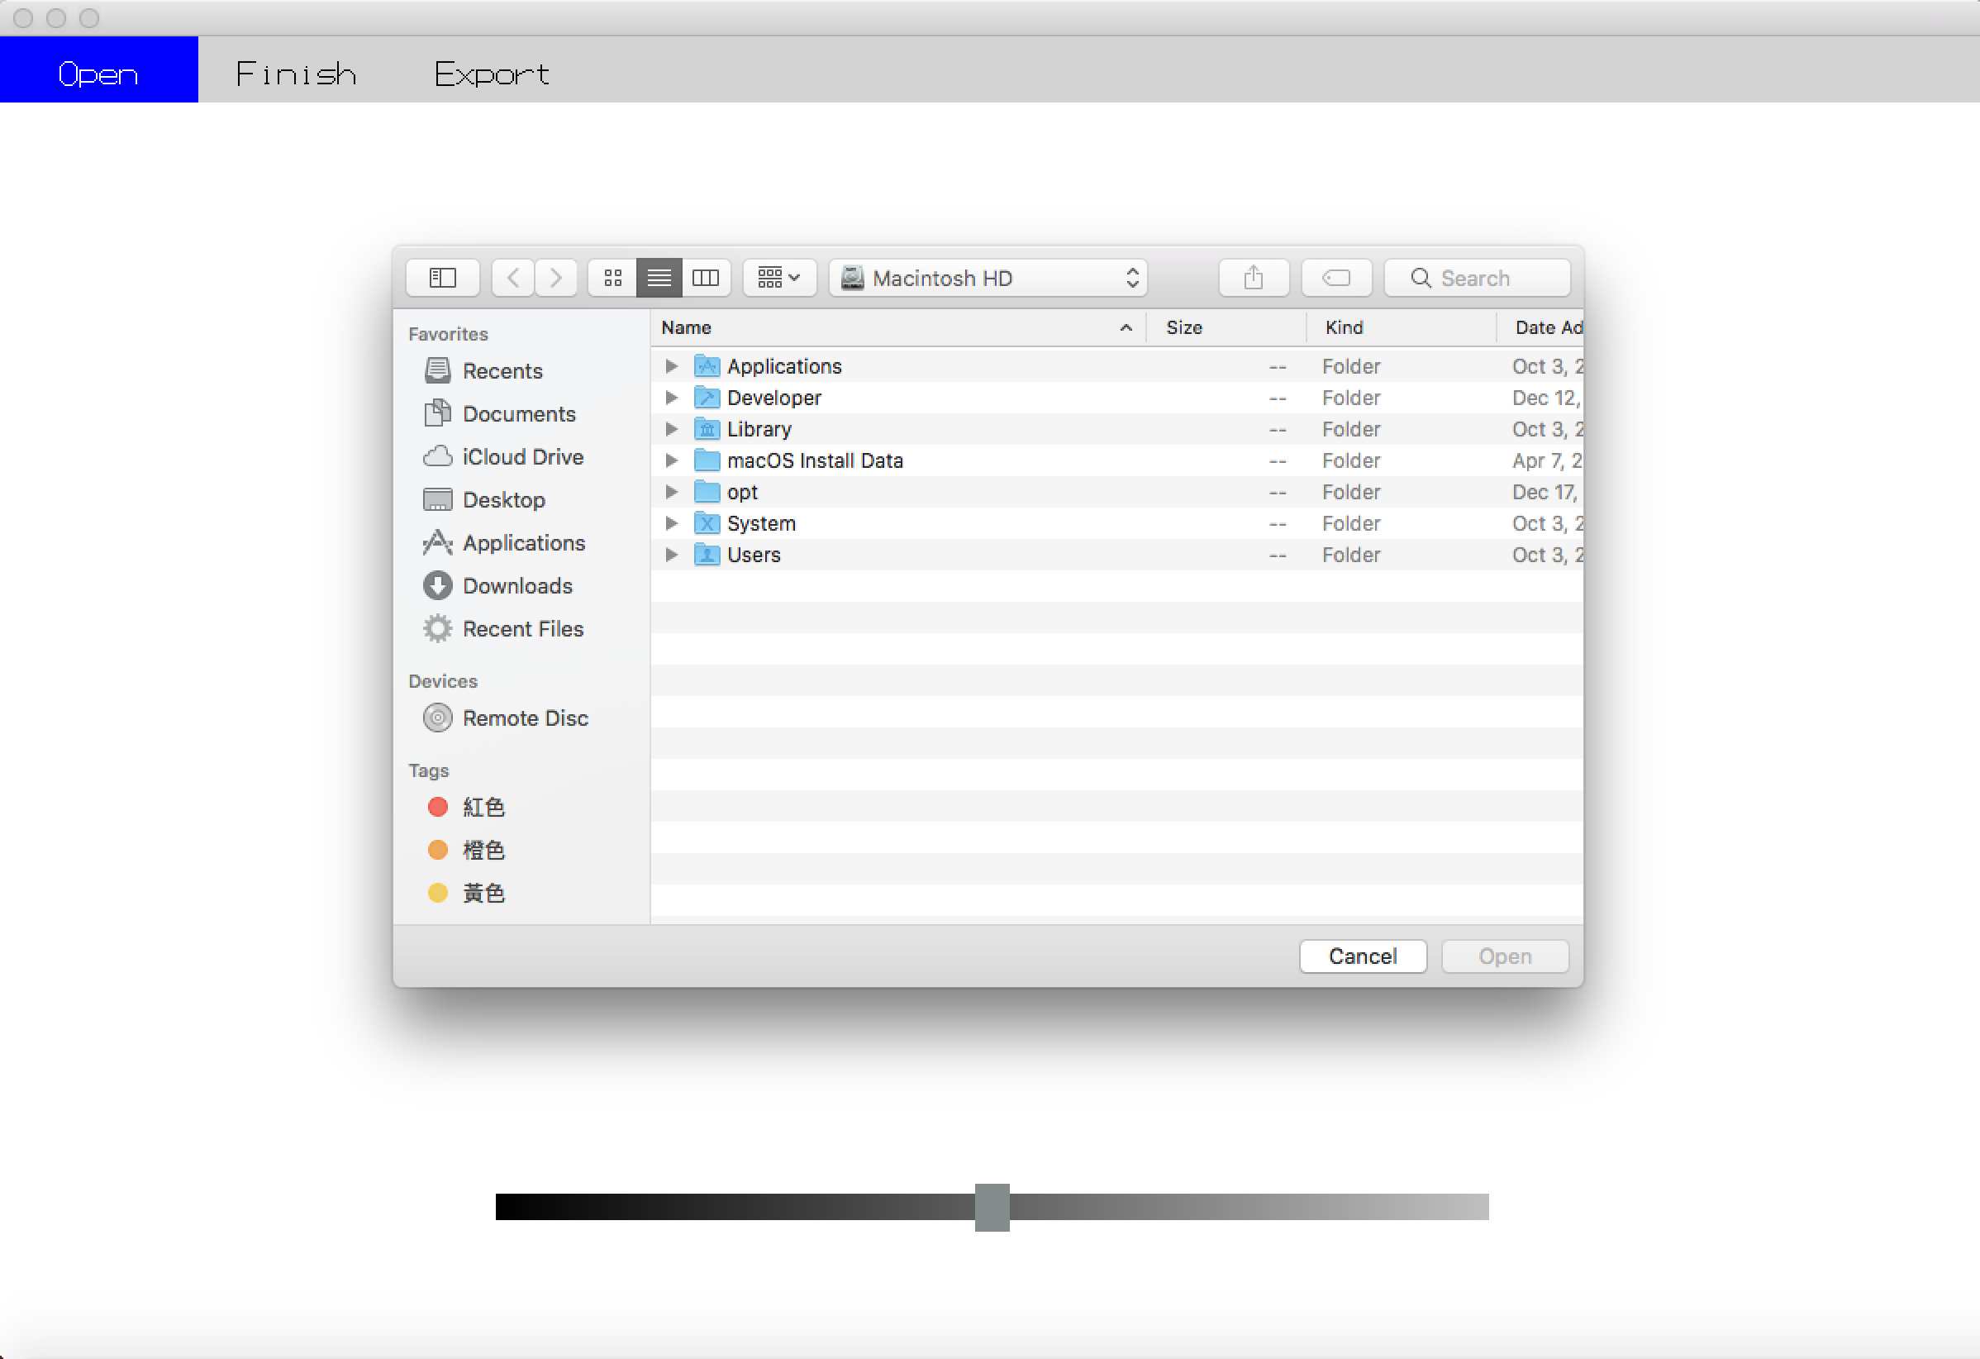
GUI/IO:
Allow user to load pictures using a file dialog.

Slide 5
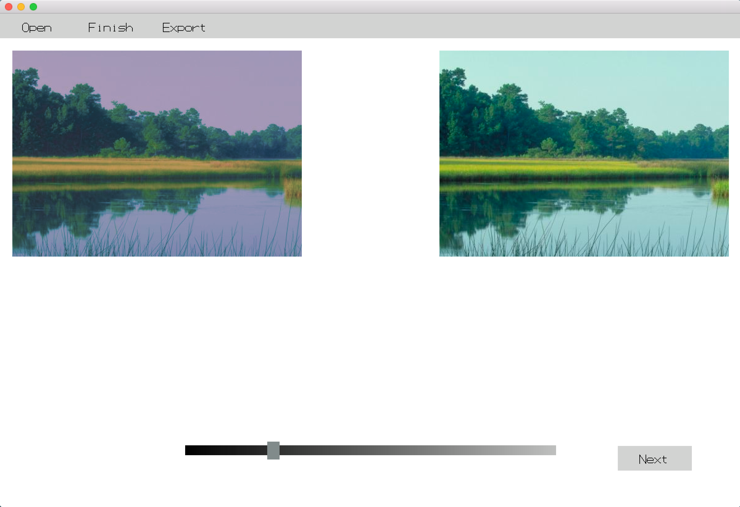
Filters:
Brightness
Contrast
Saturation
Color Balance
Red Channel
Green Channel
Blue Channel
Use the slide bar to modify the picture.

Slide 6
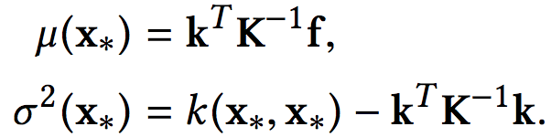
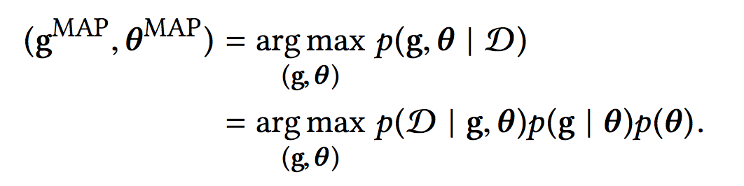

Challenges encountered so far
Data organization
NLopt package is not friendly to windows users
Complicated math…
(Solved) Run 6 filters in real-time

Slide 7
Expected Delivery
A good photo enhancement application
Directly involves human in the loop
Find best image tweaking parameters easily and automatically

Slide 8
Task to do
Refine GUI
File output
Math implementation

Slide 9
Thank You : )

